Slide 1
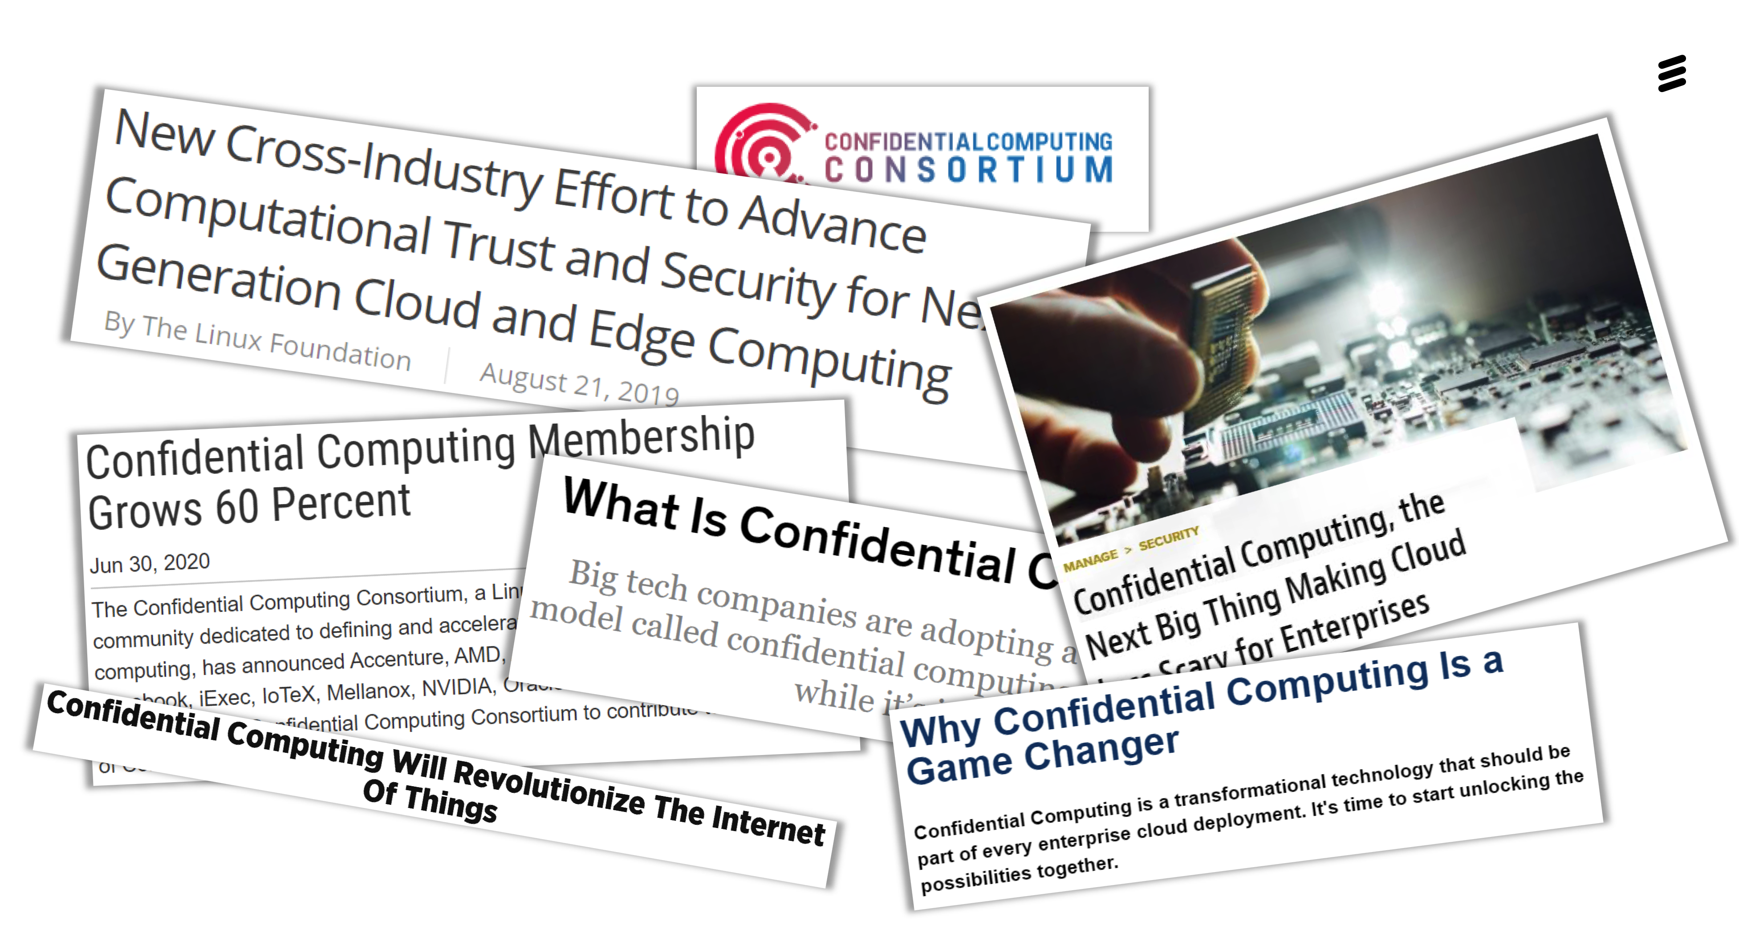
Einar Martin Aandahl, CEO, Ledidi
Schjødt - 12.05.2022

Slide 2
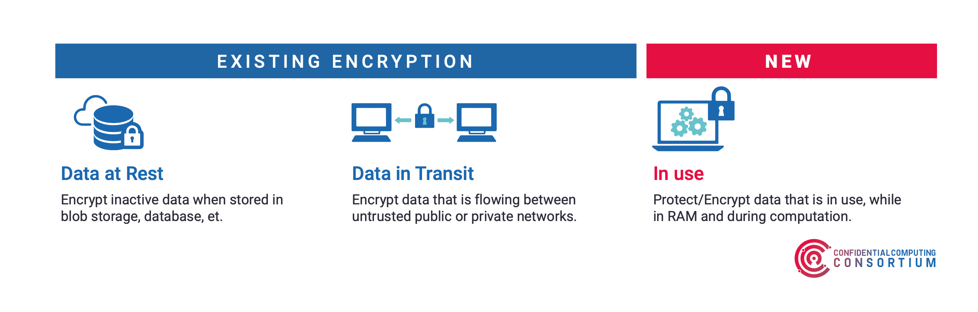

Slide 3
Confidential computing = konfidensiell prossesering
Kompletterer «klassisk» kryptering av data i transport og lagret på disk ved å beskytte data i bruk
Benytter seg av hardware teknologi for å beskytte dataene uavhengig av administrativ tilgang på skyplattformer
  Benytter «Trusted Execution Environment (TEE)»
    Krytperingteknologi
    Isolering av maskinvare

Slide 4
Confidential computing = konfidensiell prossesering
Beskytter mot de fleste kjente trusler, og baserer seg på zero trust hvor skyoperatørene tas ut av «trusted computing base - (TCB)»
Fjerner de «klassiske» sårbarhetene ved virtualisering, eks. med «gammeldagse» hypervisorer
AWS Nitro, Intel SGX / TDX, AMD Milan

Slide 5

We are using it everyday
Point-of-Sale devices use TEEs
Protect secrets such as credit card numbers, PINs, expiration dates, CVVs
In Apple iPhones from version 5s
In gaming consoles (Nintendo, xBox etc.)

Slide 6
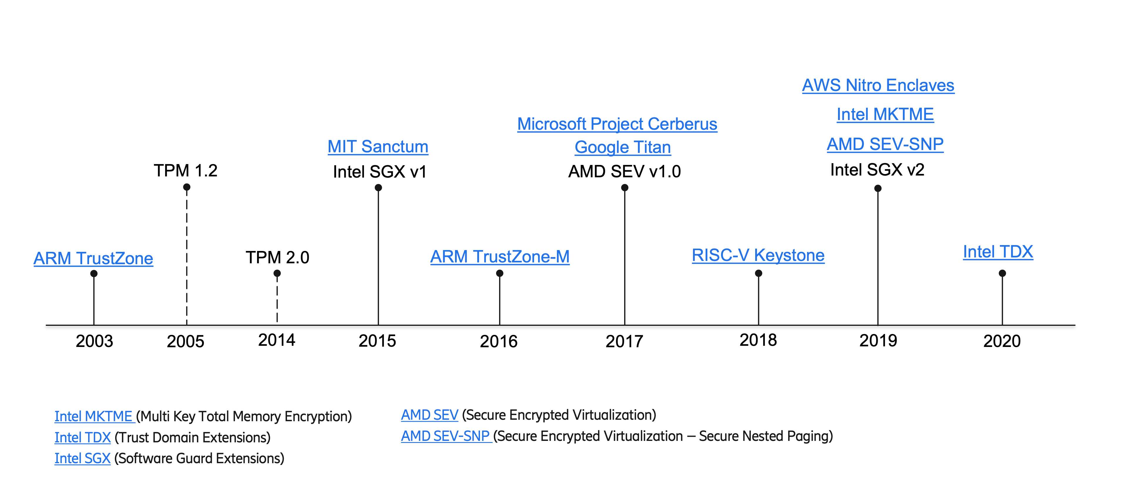

Slide 7
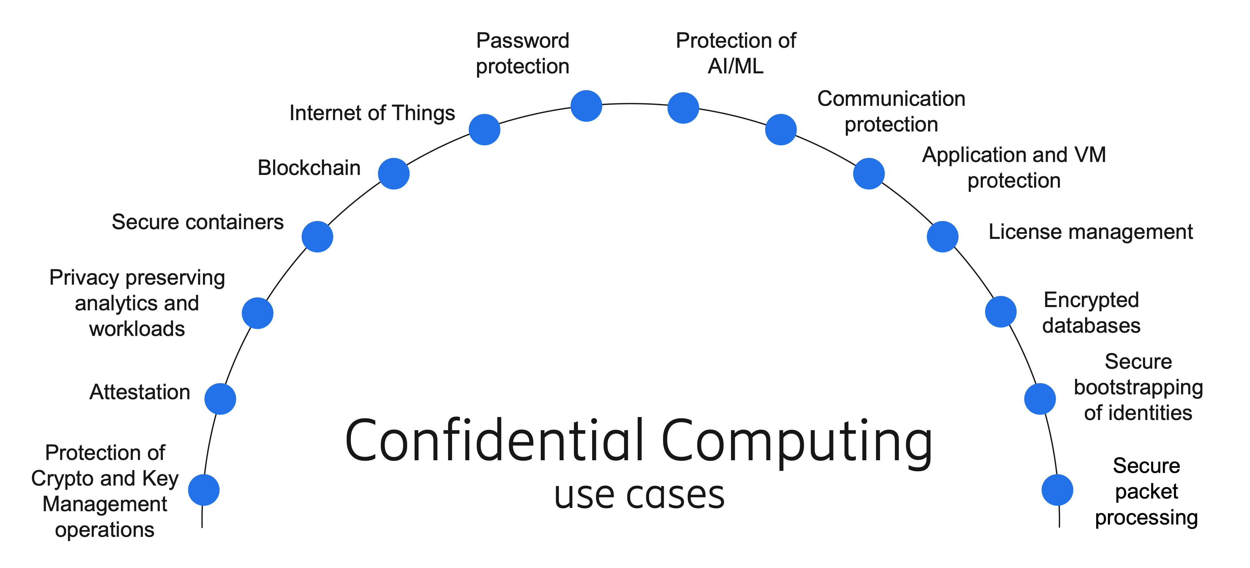

Slide 8
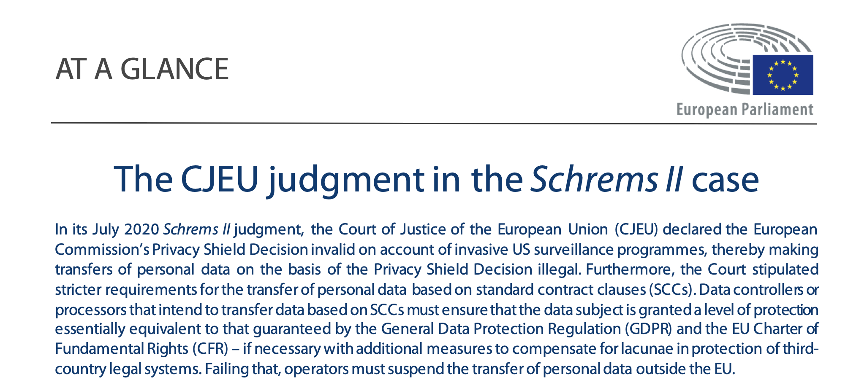

Slide 9
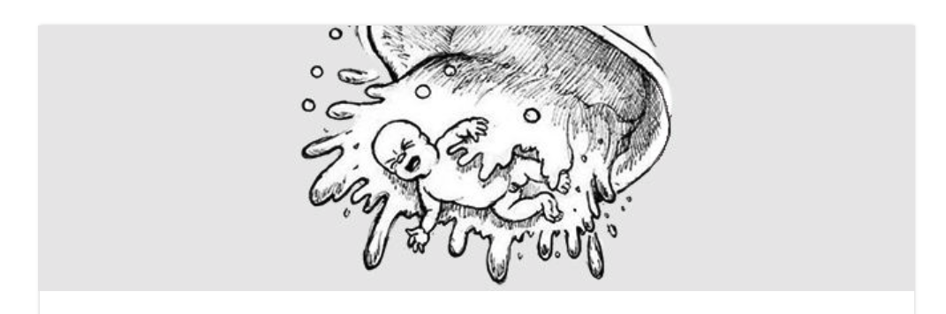
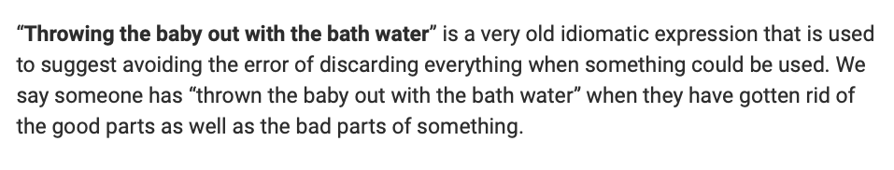

Slide 10
Clouds Are Secure: Are You Using Them Securely?
Gartner; 7 October 2019
Unfortunately, much of the IT world continues to operate under a counterproductive misconception about the relative security posture of public clouds — namely that shared cloud infrastructure is inherently risky.
Ironically, avoidance of cloud services may even lead to unnecessary security risks, as organizations continue to rely on poorly managed in-house systems that often have more security vulnerabilities than their public cloud equivalents.
https://www.gartner.com/document/code/00350439?ref=authbody&refval=3987571

Slide 11

Clouds Are Secure: Are You Using Them Securely?
Gartner; 7 October 2019
https://www.gartner.com/document/code/00350439?ref=authbody&refval=3987571

Slide 12
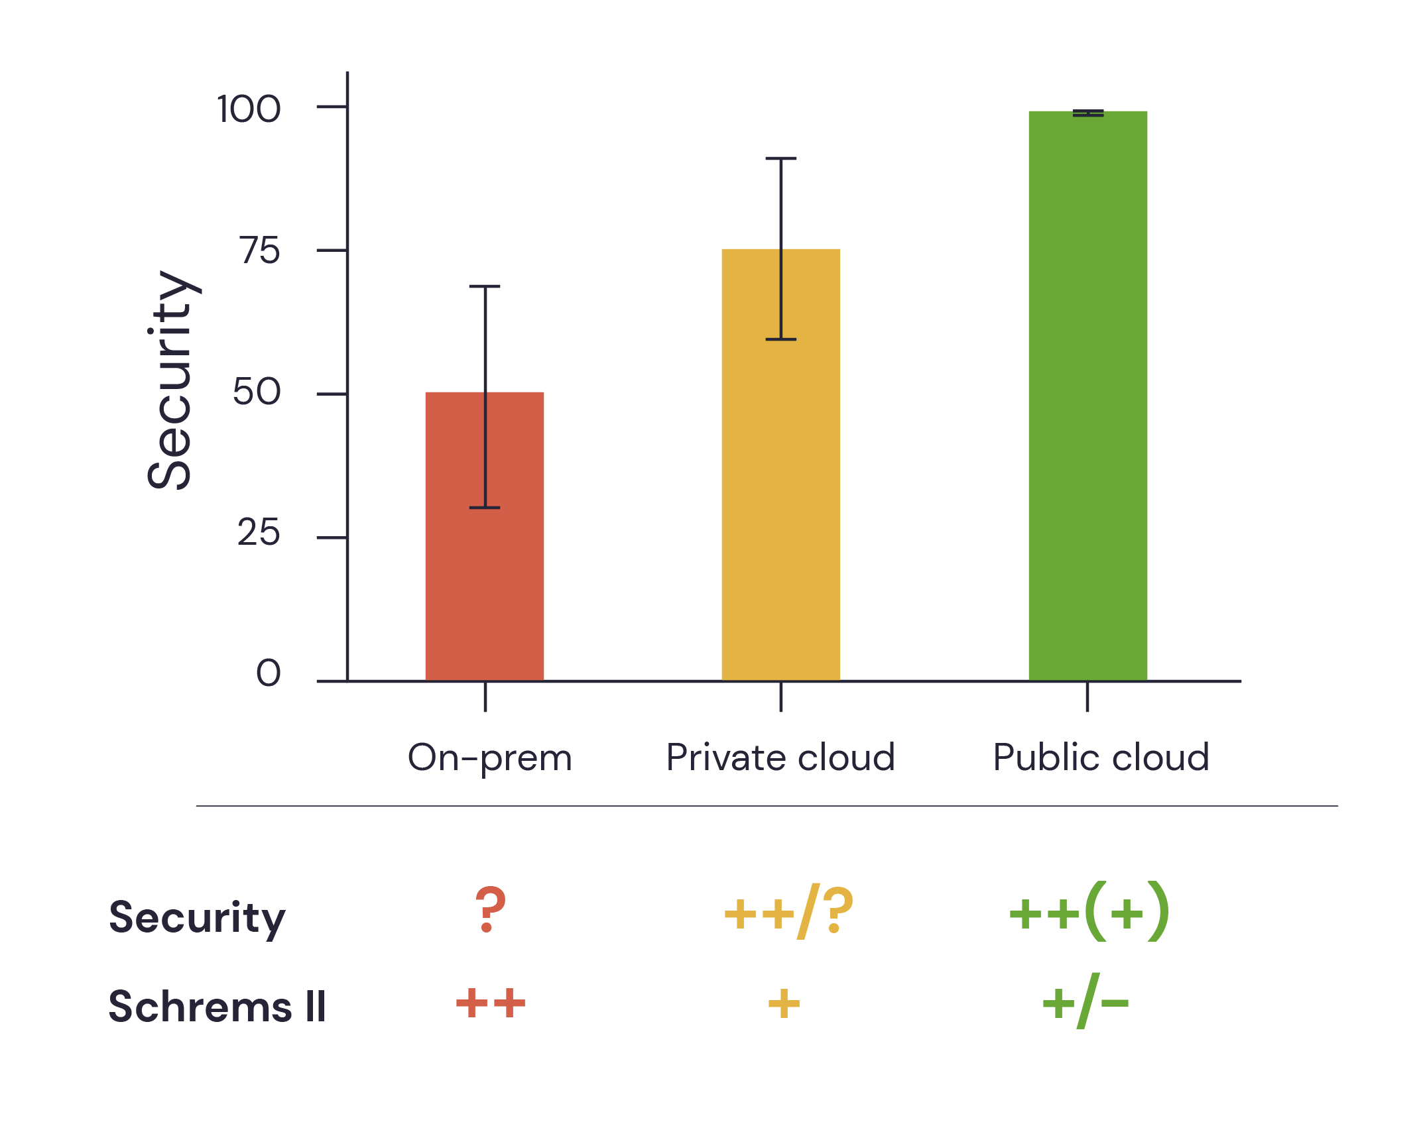

Slide 13
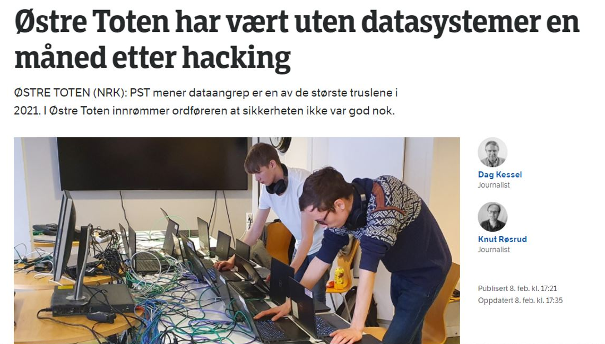

Slide 14

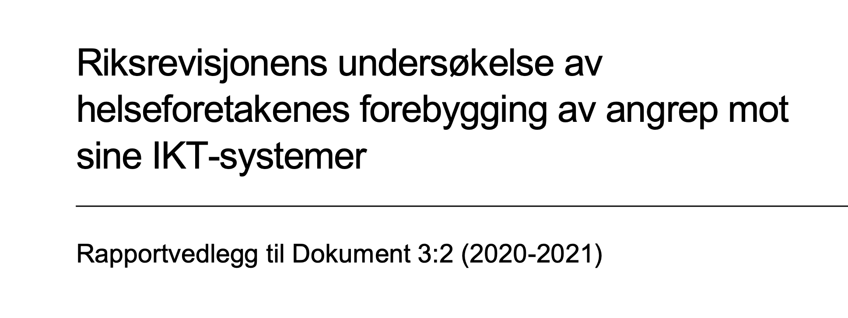
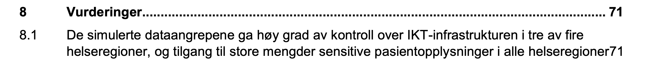

Slide 15
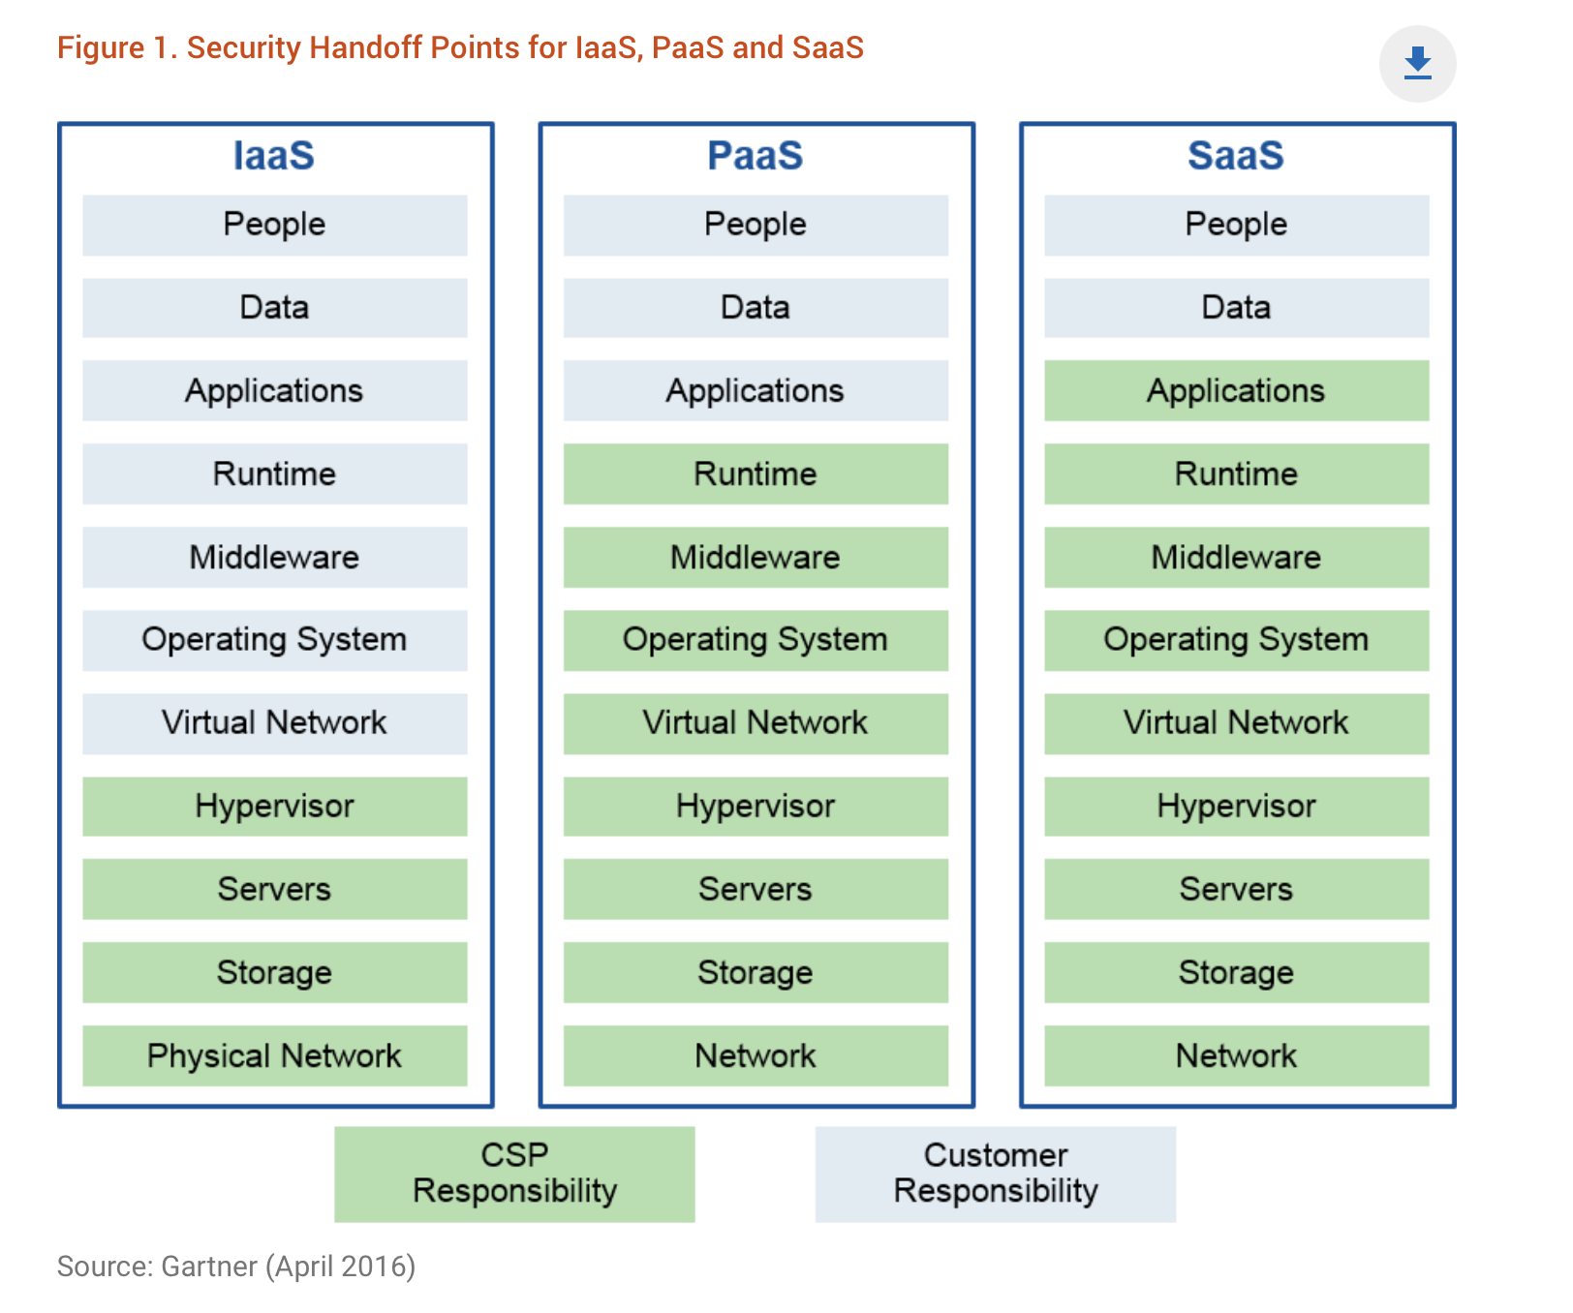
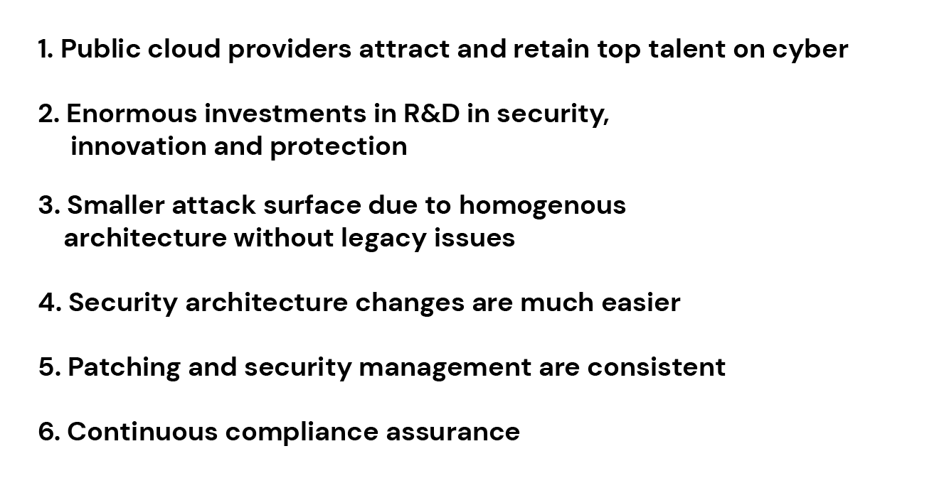

Slide 18
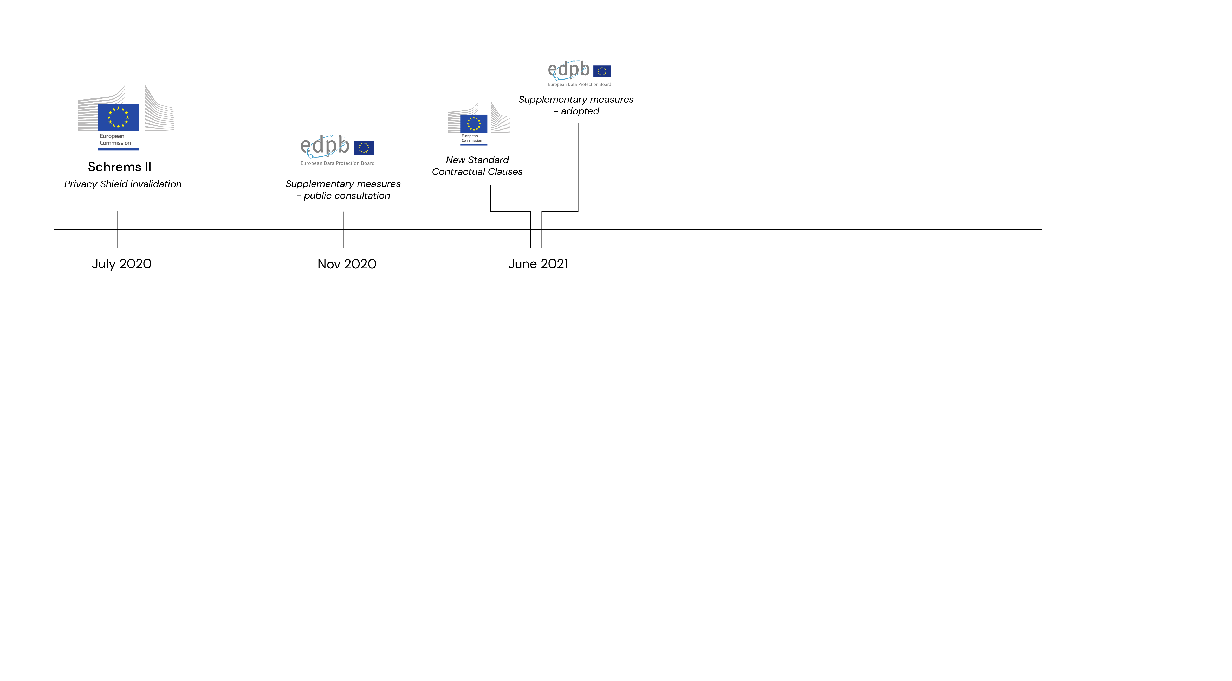

Slide 19
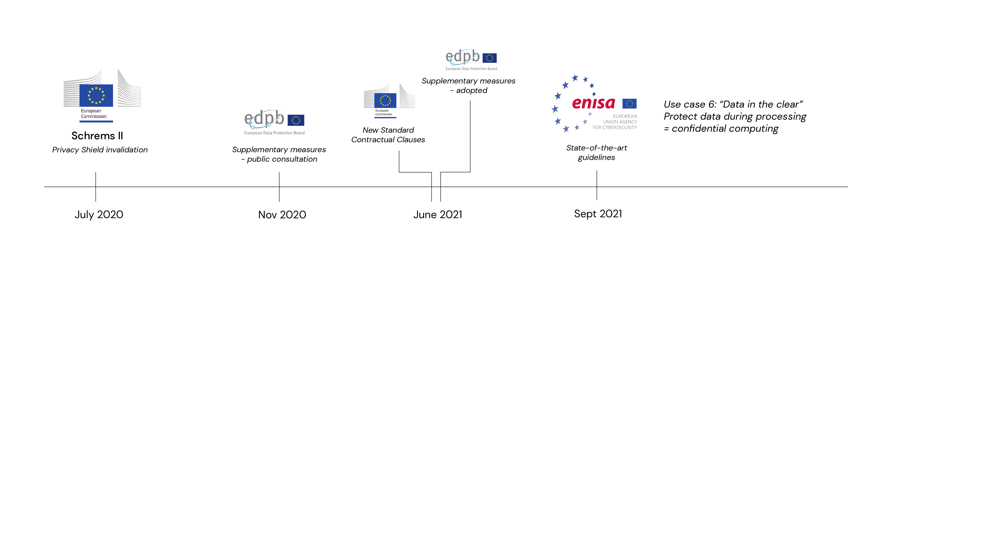

Slide 20
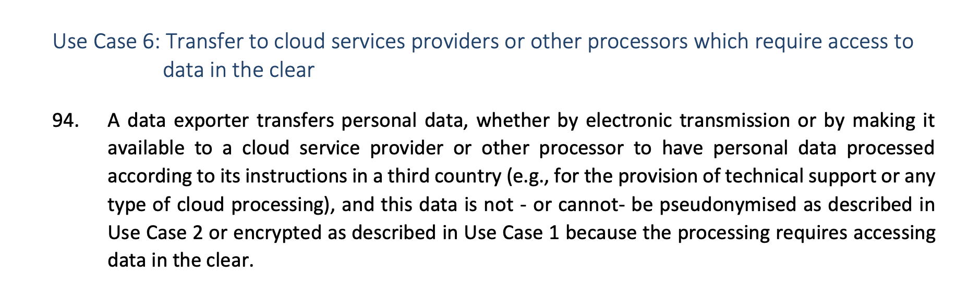
https://edpb.europa.eu/system/files/2021-06/edpb_recommendations_202001vo.2.0_supplementarymeasurestransferstools_en.pdf

Slide 21
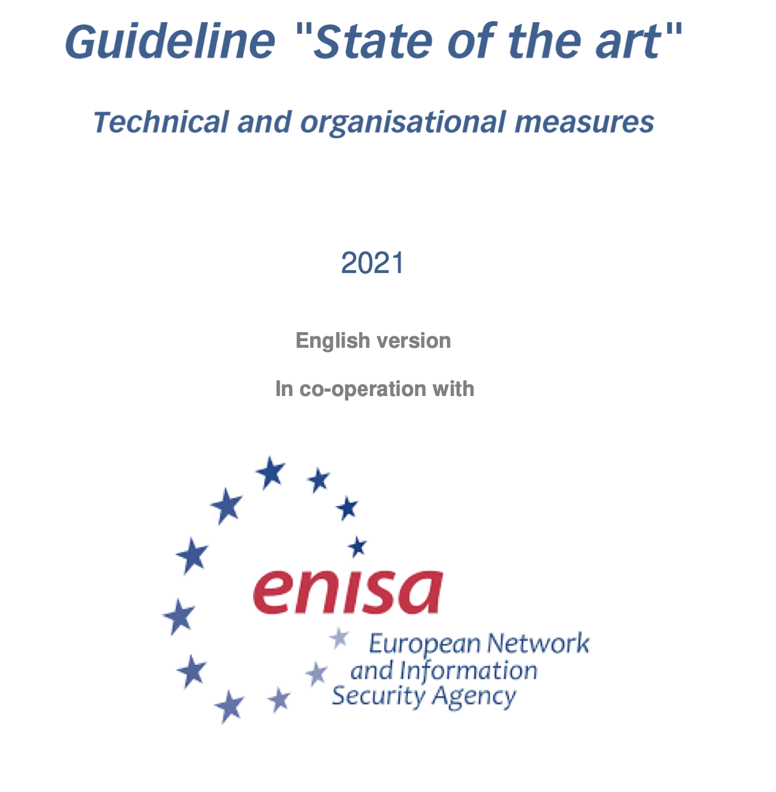

Slide 22
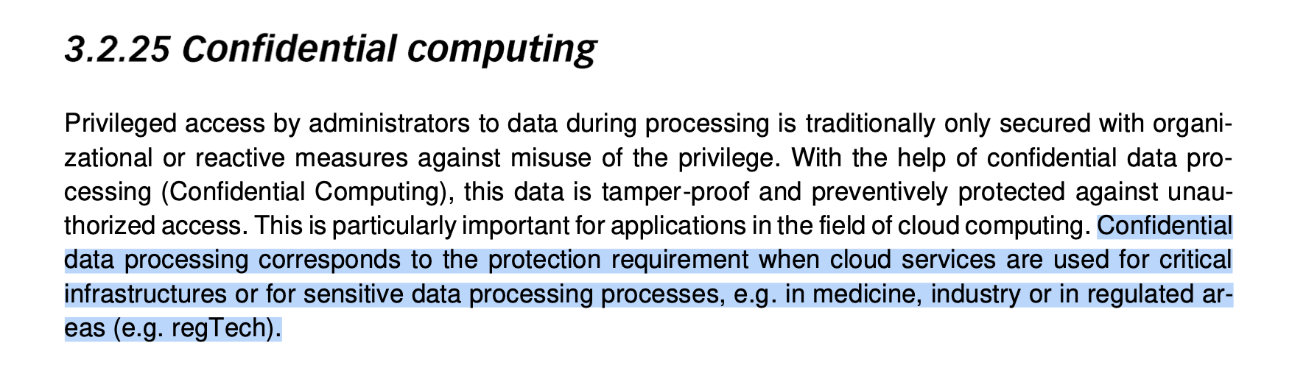

Slide 23
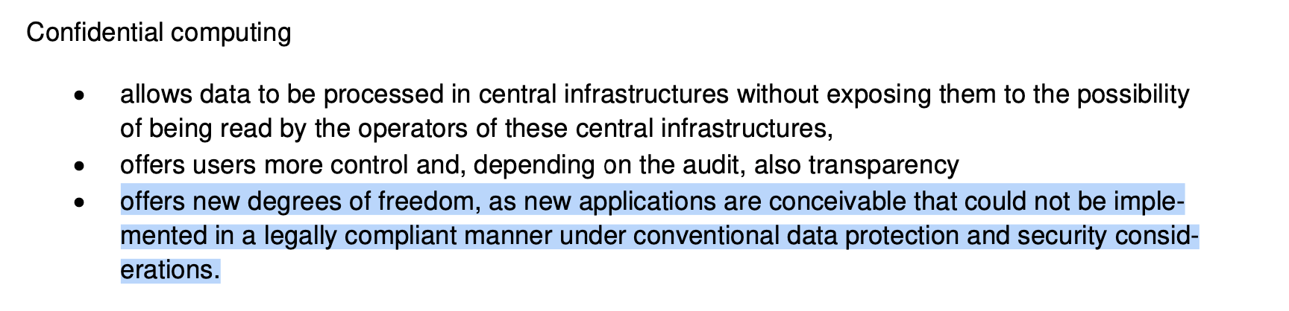

Slide 24
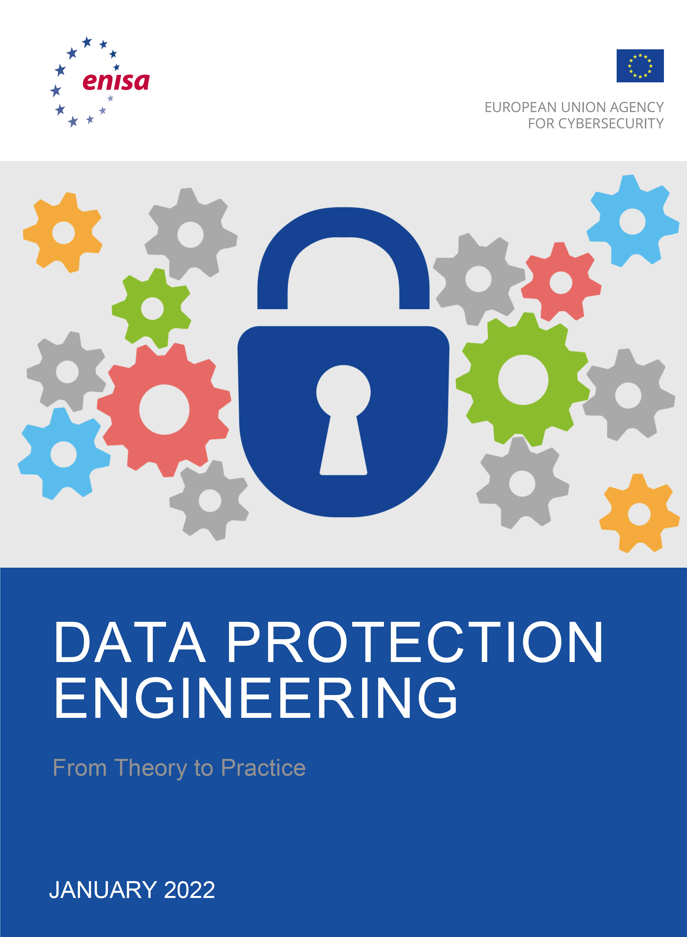
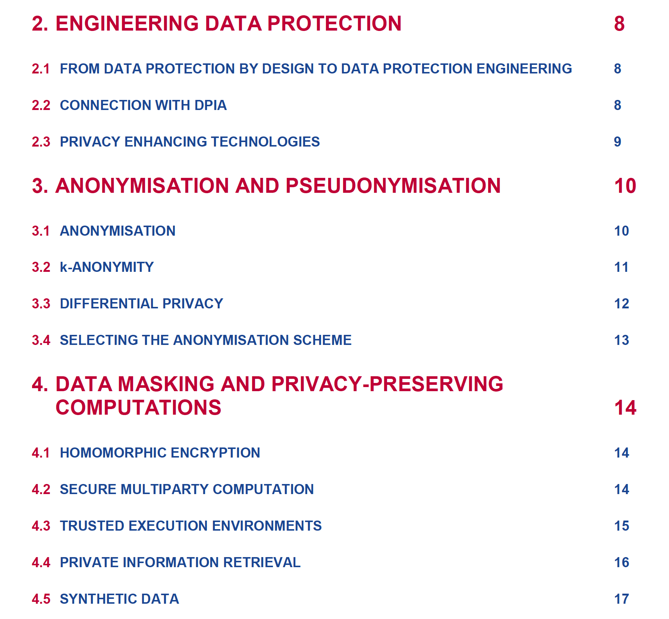

Slide 25
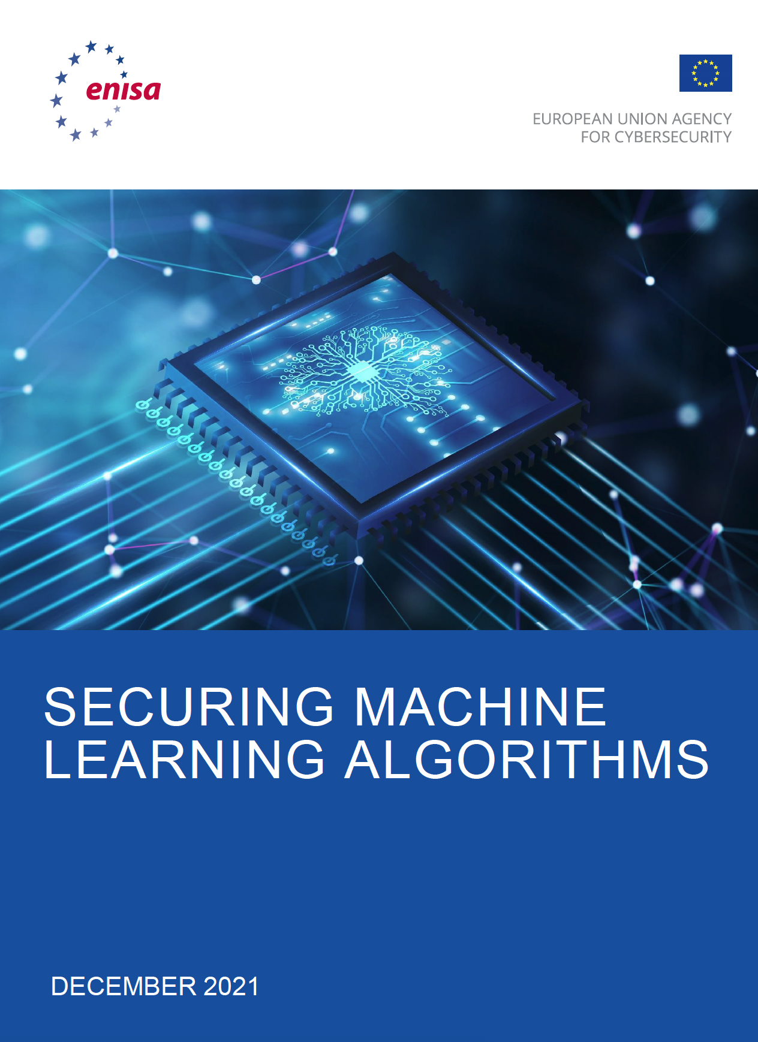
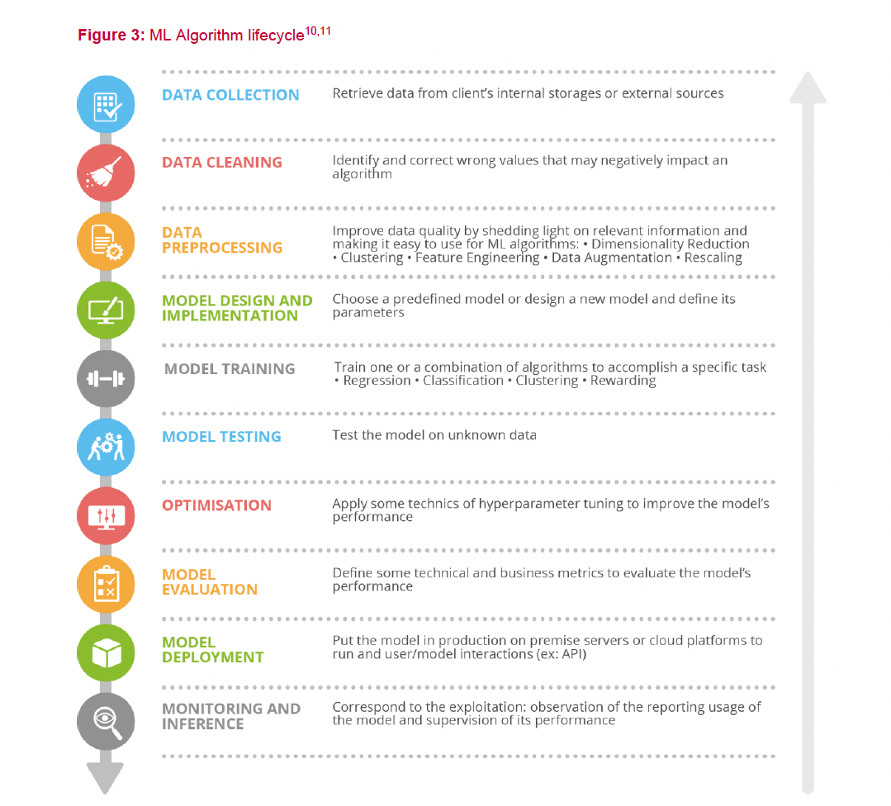

Slide 26
State-of-the art guidelines fra ENISA og løser use case 6 i EDPB suppl. Measures
https://www.enisa.europa.eu/news/enisa-news/what-is-state-of-the-art-in-it-security
Generelle retningslinjer fra ENISA
(https://www.enisa.europa.eu/publications/data-protection-engineering)
I praksis en forutsetning for auto-ML / AI løsninger mtp dataintegritet, kodebeskyttelse og personvern i ENISA-guidelines
(https://www.enisa.europa.eu/news/enisa-news/artificial-intelligence-how-to-make-machine-learning-cyber-secure)
Tilgjengelig fullskala hos AWS (AWS Nitro), men blir innføres raskt «over alt»
Gir Public Cloud ytterligere forsprang i datasikkerhet og personvern i praksis
  Vanskelig å oppfylle kravene i retningslinjene fra ENISA hvis man IKKE benytter public cloud

Slide 27
Protects confidentiality, data integrity and code integrity
Data confidentiality
Prevents unauthorized access from other applications, OS, hypervisor, system administrators, service providers, and the infrastructure owner — or anyone else with physical access to the hardware
Data integrity
Data integrity is preventing unauthorized entities from altering data when data is being processed (auto-ML / AI)
Code integrity
Code integrity means that the code in the TEE cannot be replaced or modified by unauthorized entities (auto-ML / AI)

Slide 28
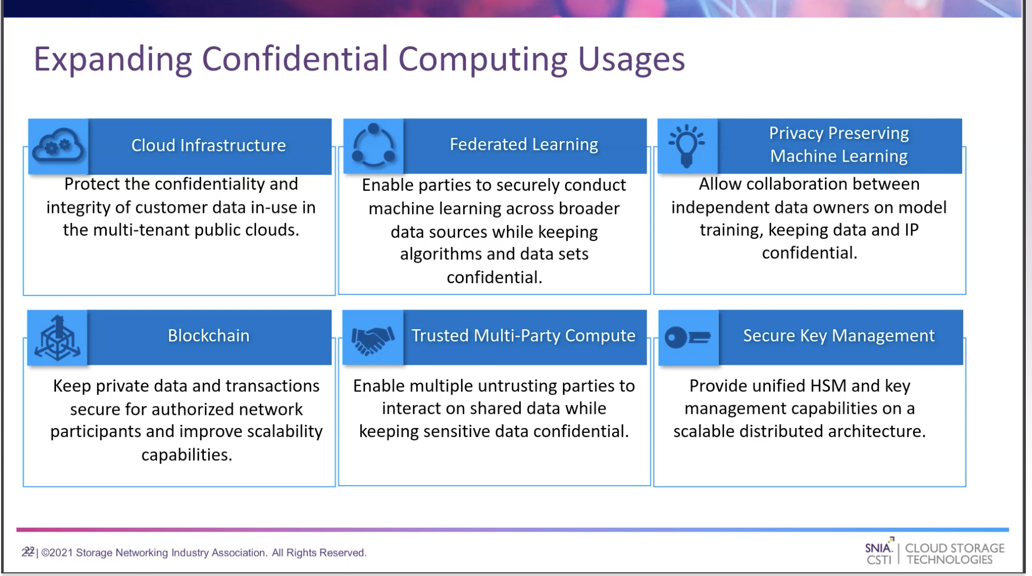

Slide 31
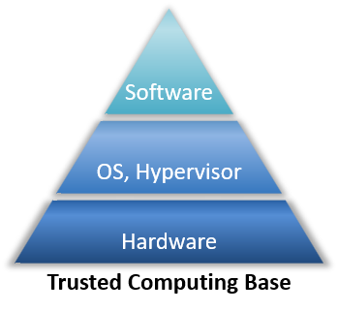

Slide 32
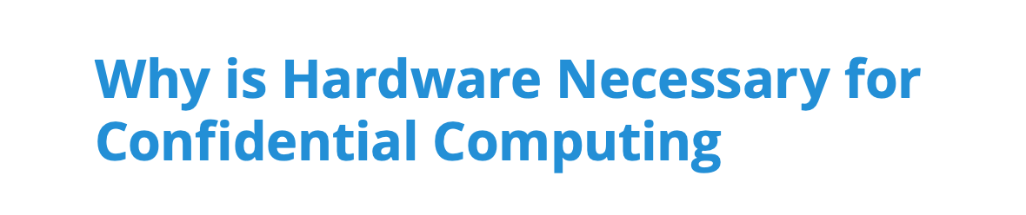
Security is only as strong as the layers below it
Security in any layer of the compute stack could potentially be circumvented by a breach at an underlying layer
This drives the need for security solutions at the lowest layers possible, down to the silicon components of the hardware.
By providing security though the lowest layers of hardware, it is possible to remove the operating system and device driver vendors, platform and peripheral vendors, and service providers and their admins, from the list of required trusted parties, thereby reducing exposure to potential compromise.
Confidential Computing aims to allow the removal of even the cloud provider from the Trusted Computing Base
https://confidentialcomputing.io/wp-content/uploads/sites/85/2021/03/confidentialcomputing_outreach_whitepaper-8-5x11-1.pdf

Slide 33
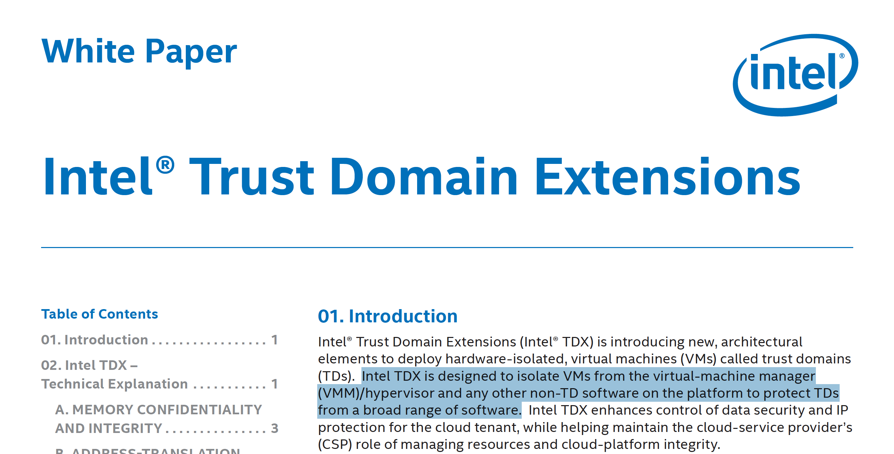

Slide 34
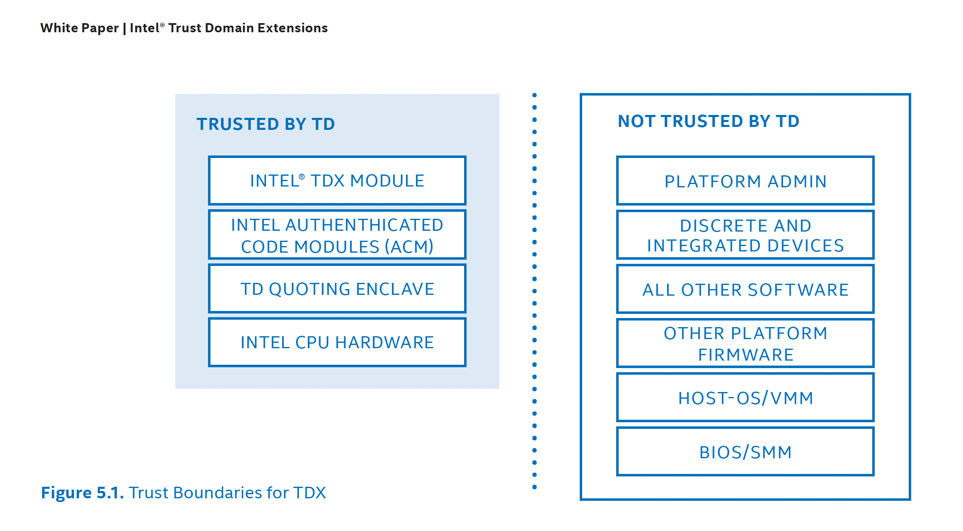
Tillit kundene må er kun basert på hardware (root of trust, trusted domain). Software, administratorer, OS, hypervisor, OS, BIOS etc har ikke tilgang til ubeskyttede data, og er ikke en del av Trusted Computing Base (TCB), dvs. utenfor Trust Boundary

Slide 35
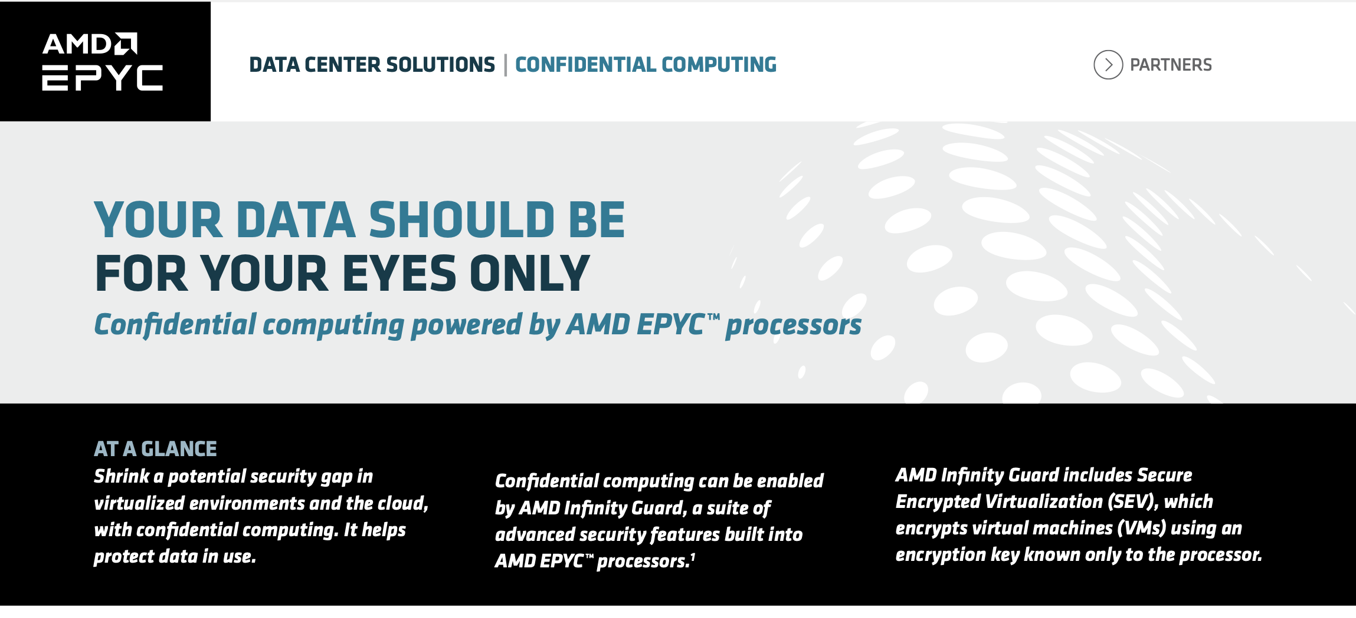
Tilsvarende teknologi hos AMD

Slide 36
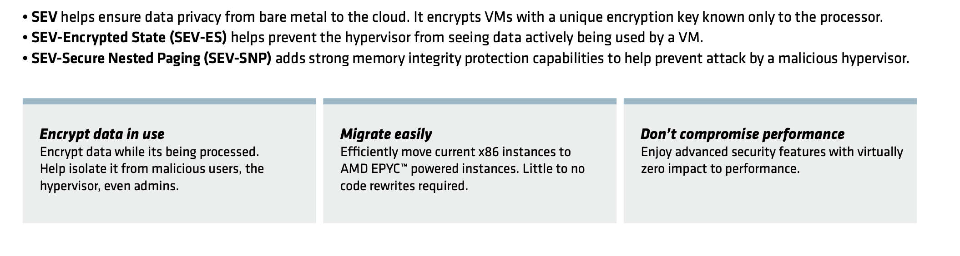

Slide 37
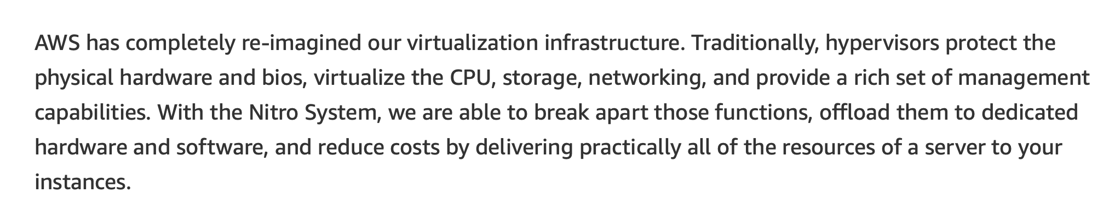
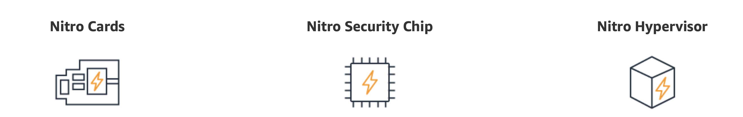
AWS Nitro – arkitektur spesielt designet for å utvikle Trusted Execution Environment, og kombinerer sikkerhet uten å redusere kapasitet

Slide 38
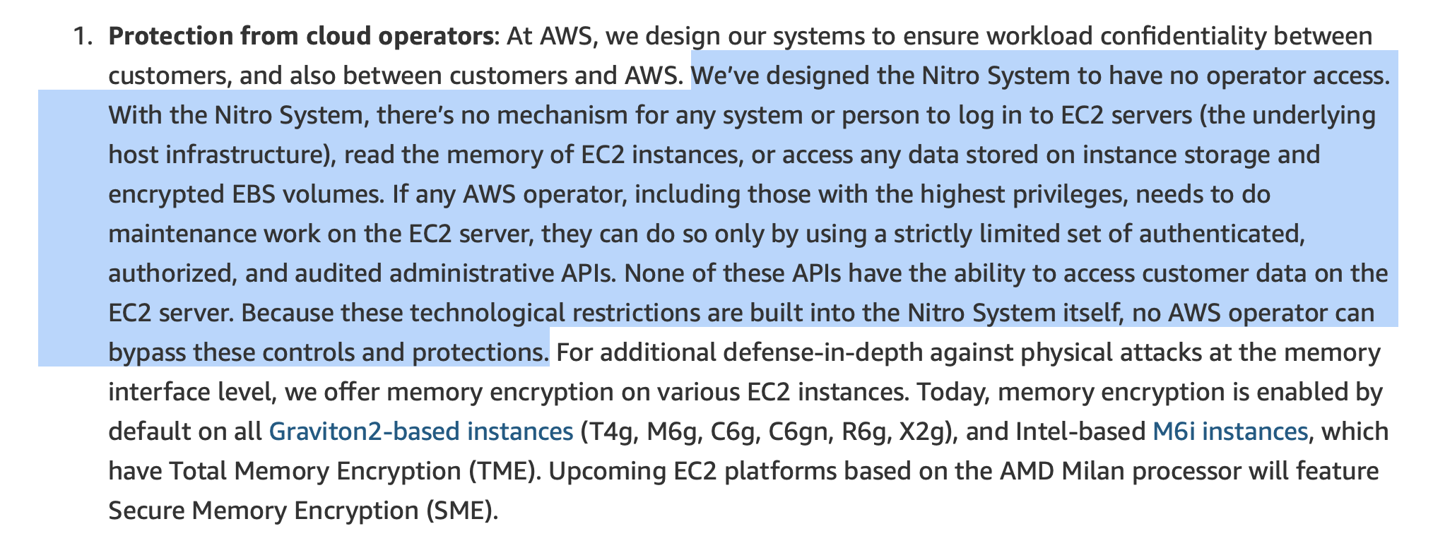
AWS Nitro: 1) Hardware isolering

Slide 39
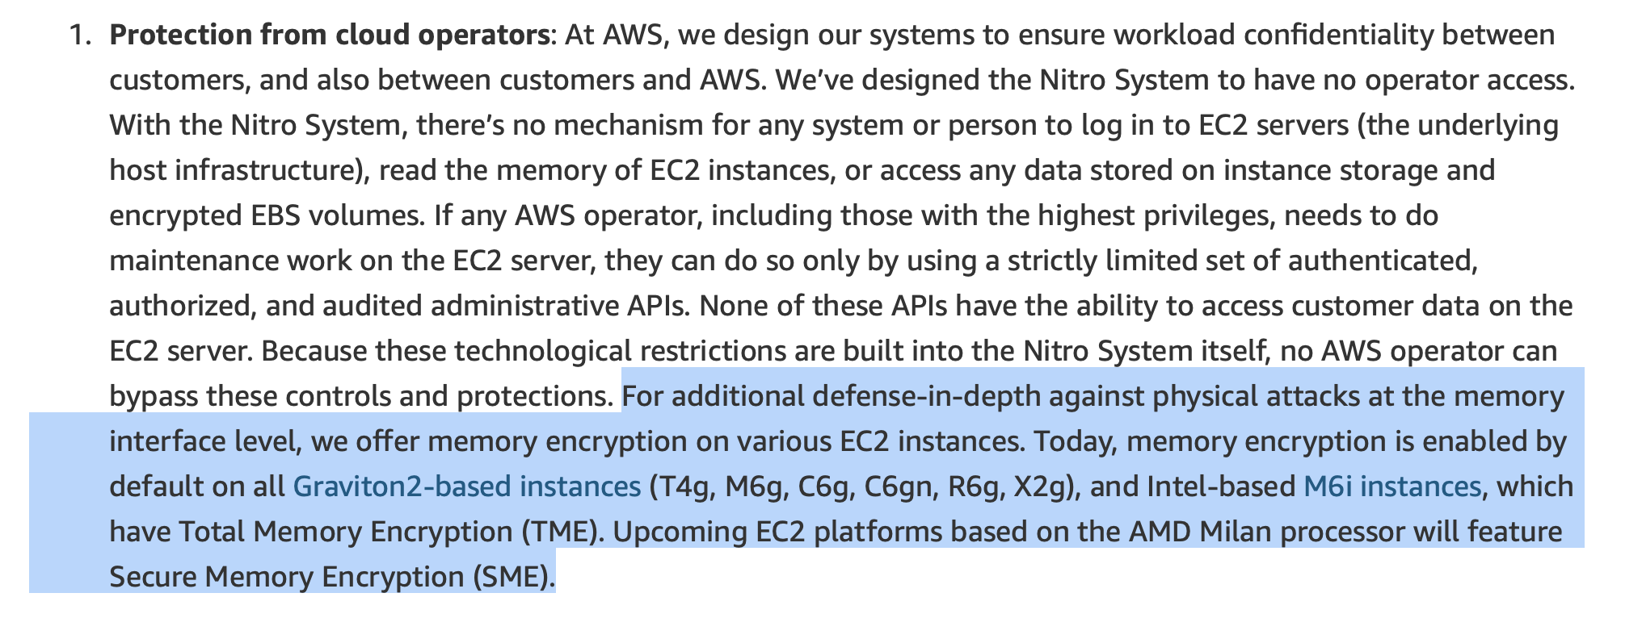
AWS Nitro: 2) Minne kryptering

Slide 40
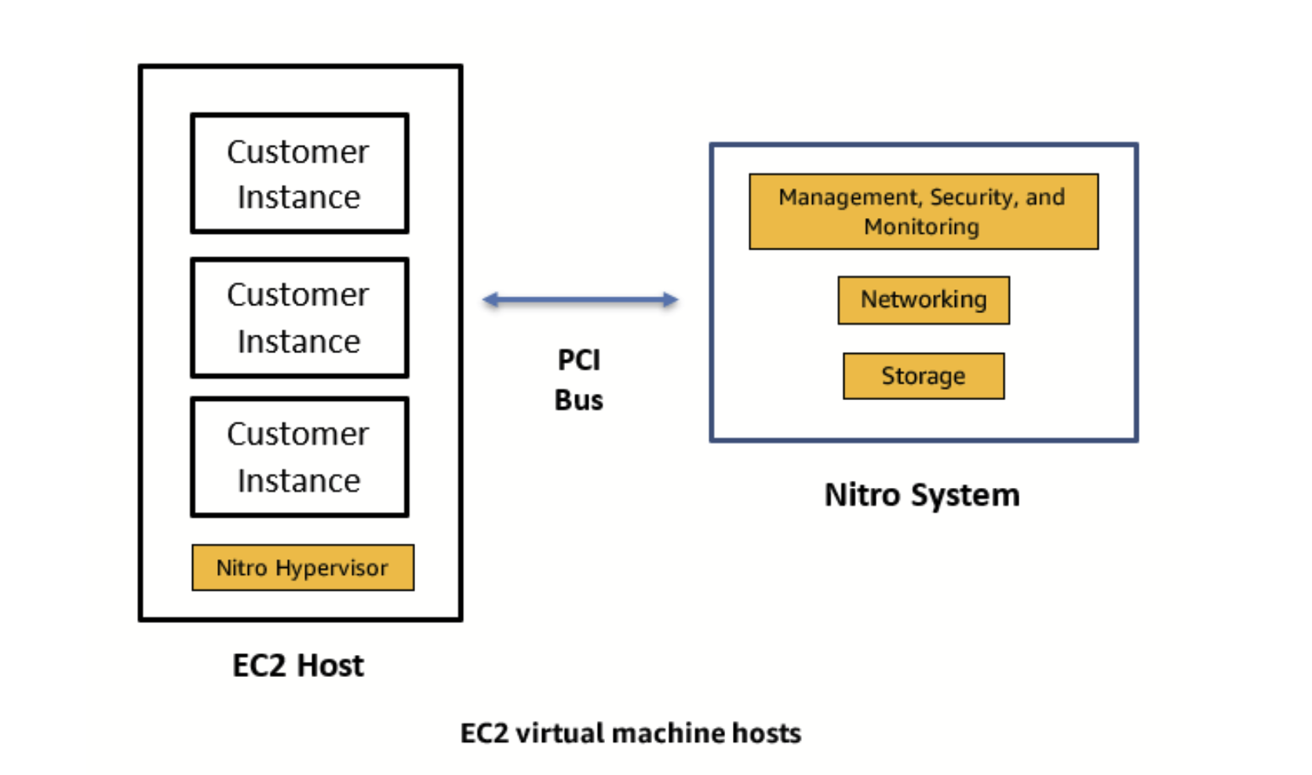

Slide 41
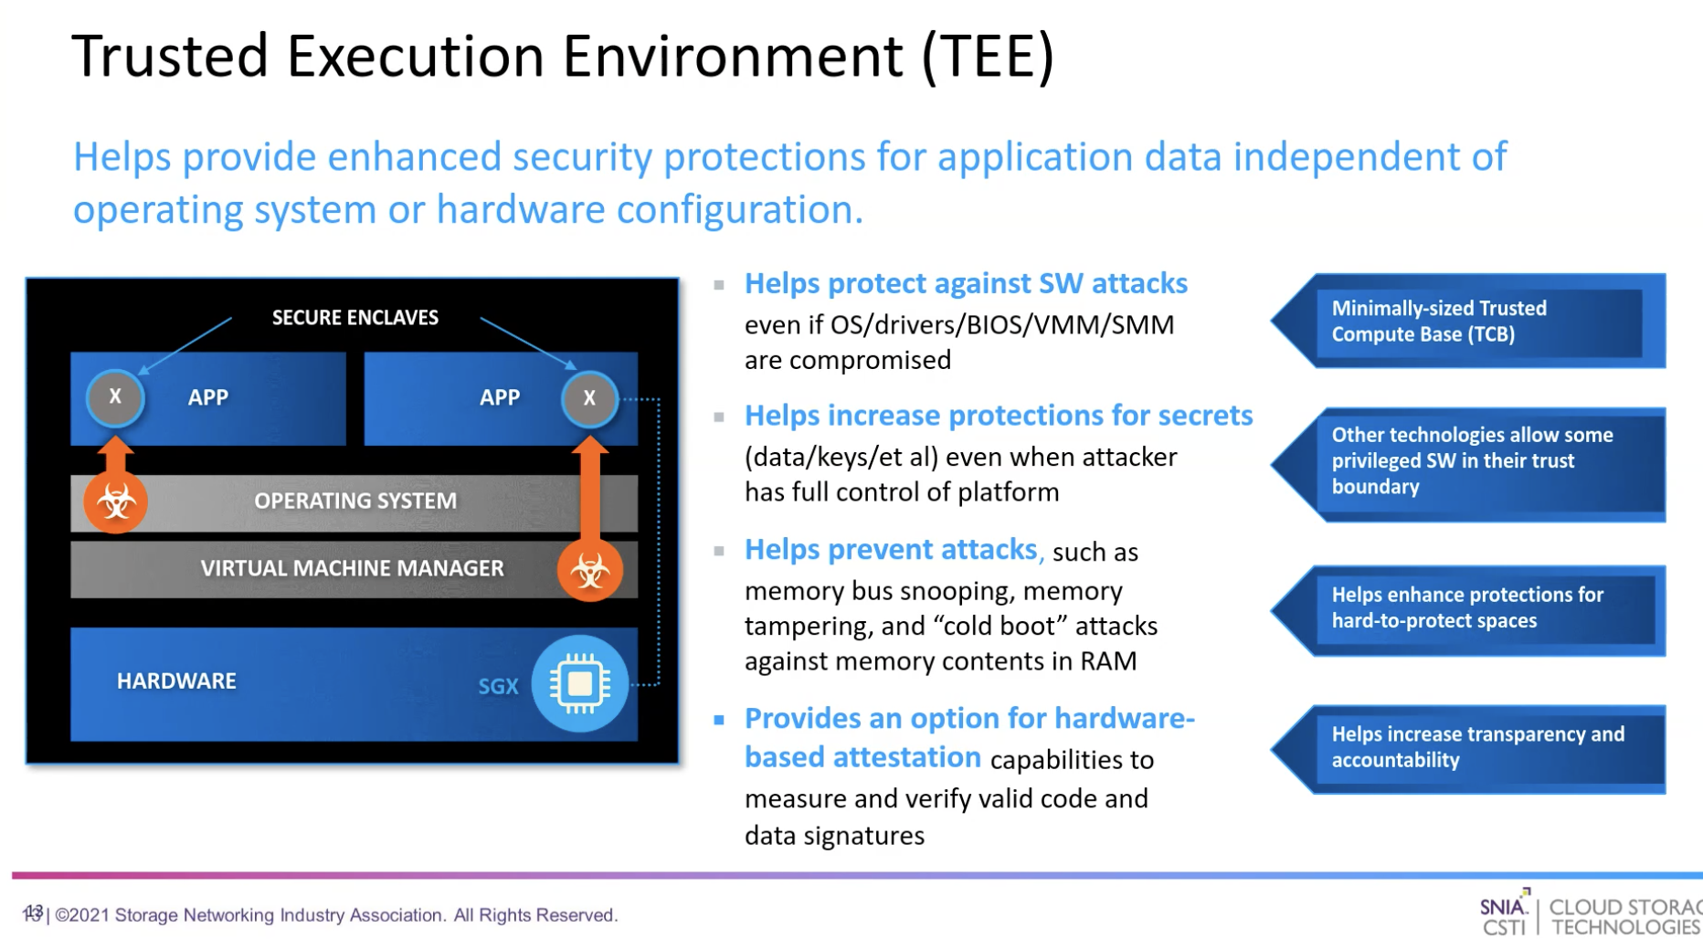

Slide 42
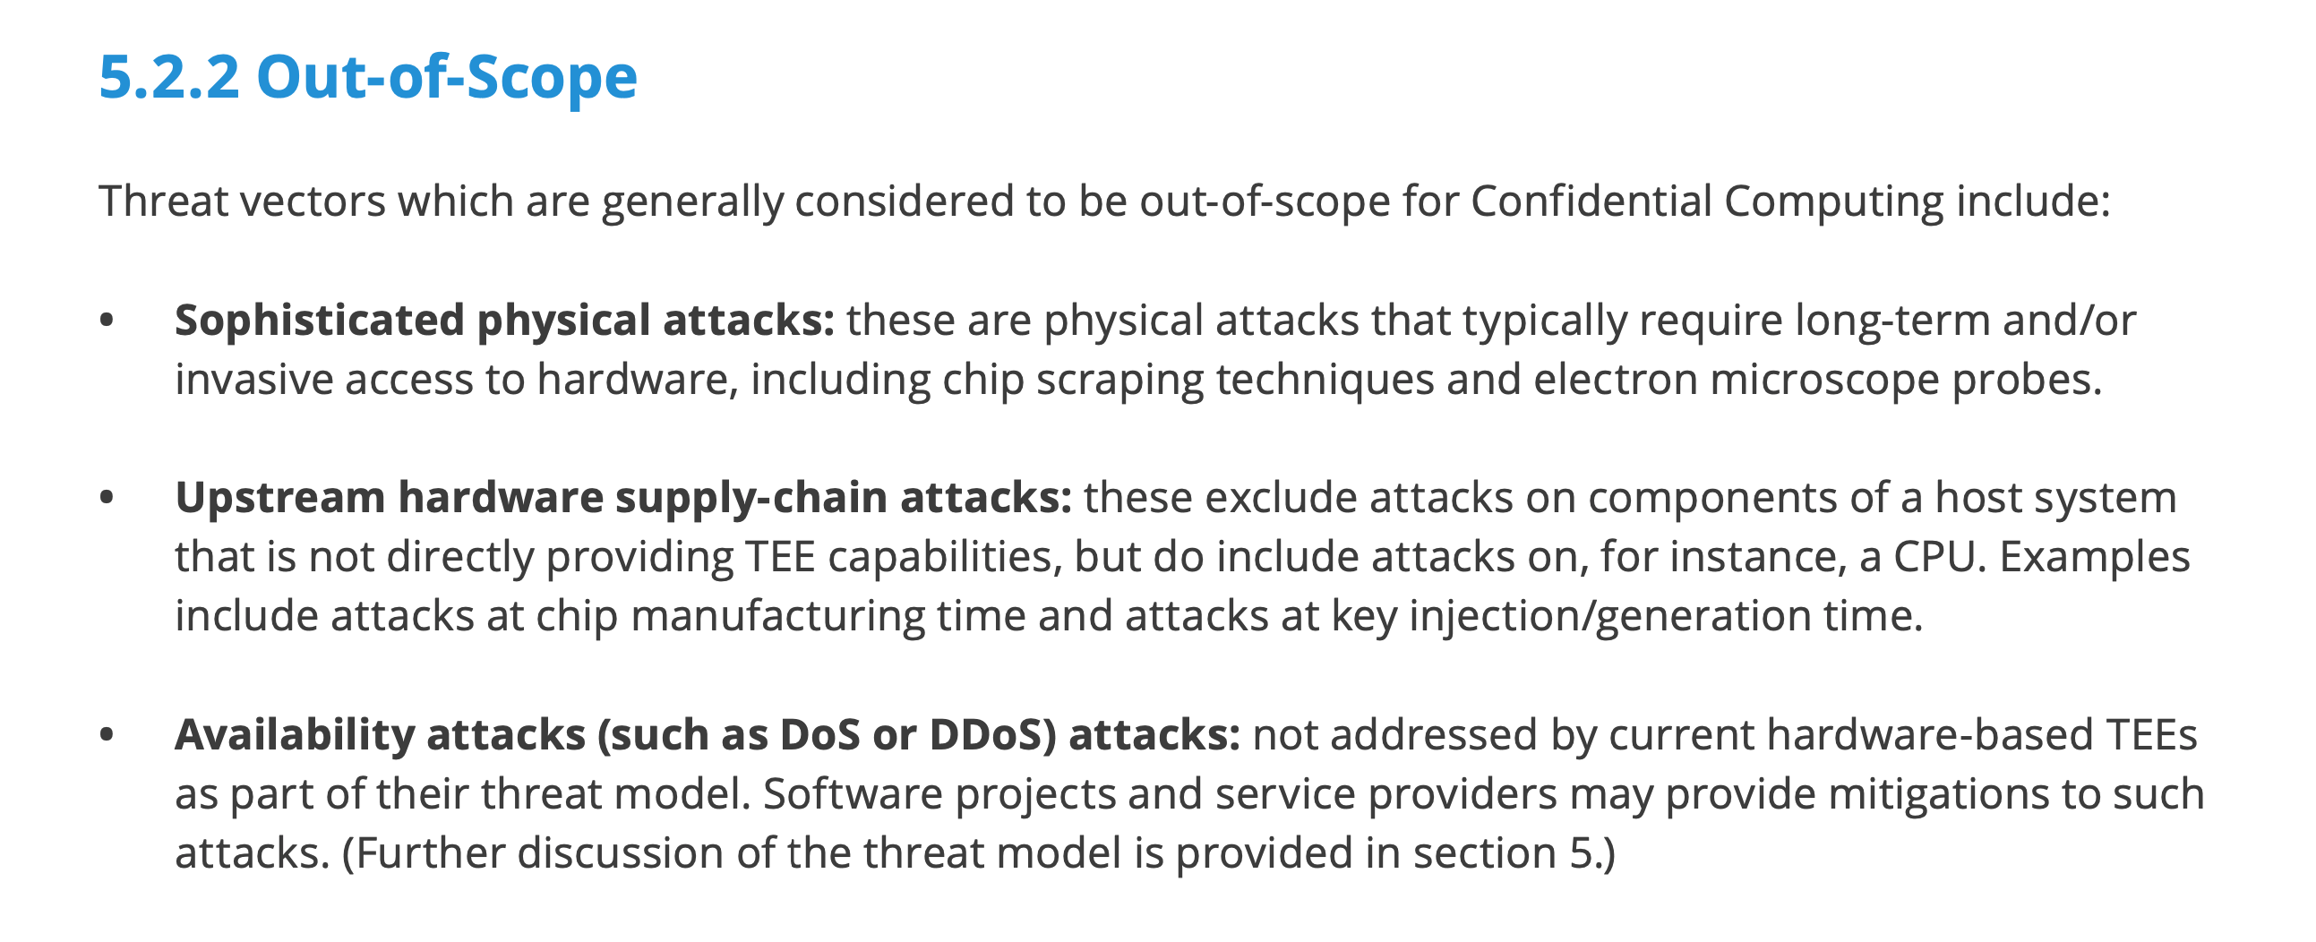

Slide 45
Multi-party computation
Multiple parties have private data that needs to be combined and analyzed without exposing the underlying data
Preventing fraud in financial services
Medical research
Business analytics
Example: Multiple hospitals could combine data to train a machine learning model to more accurately detect a disease. Individual patient data would be kept confidential, even in the event of a breach.
The data can be combined and analyzed within the TEE, and the results can be sent in an encrypted format back to each party. Data remains protected throughout the entire process: while it is transferred, during computation, and while stored.

Slide 46
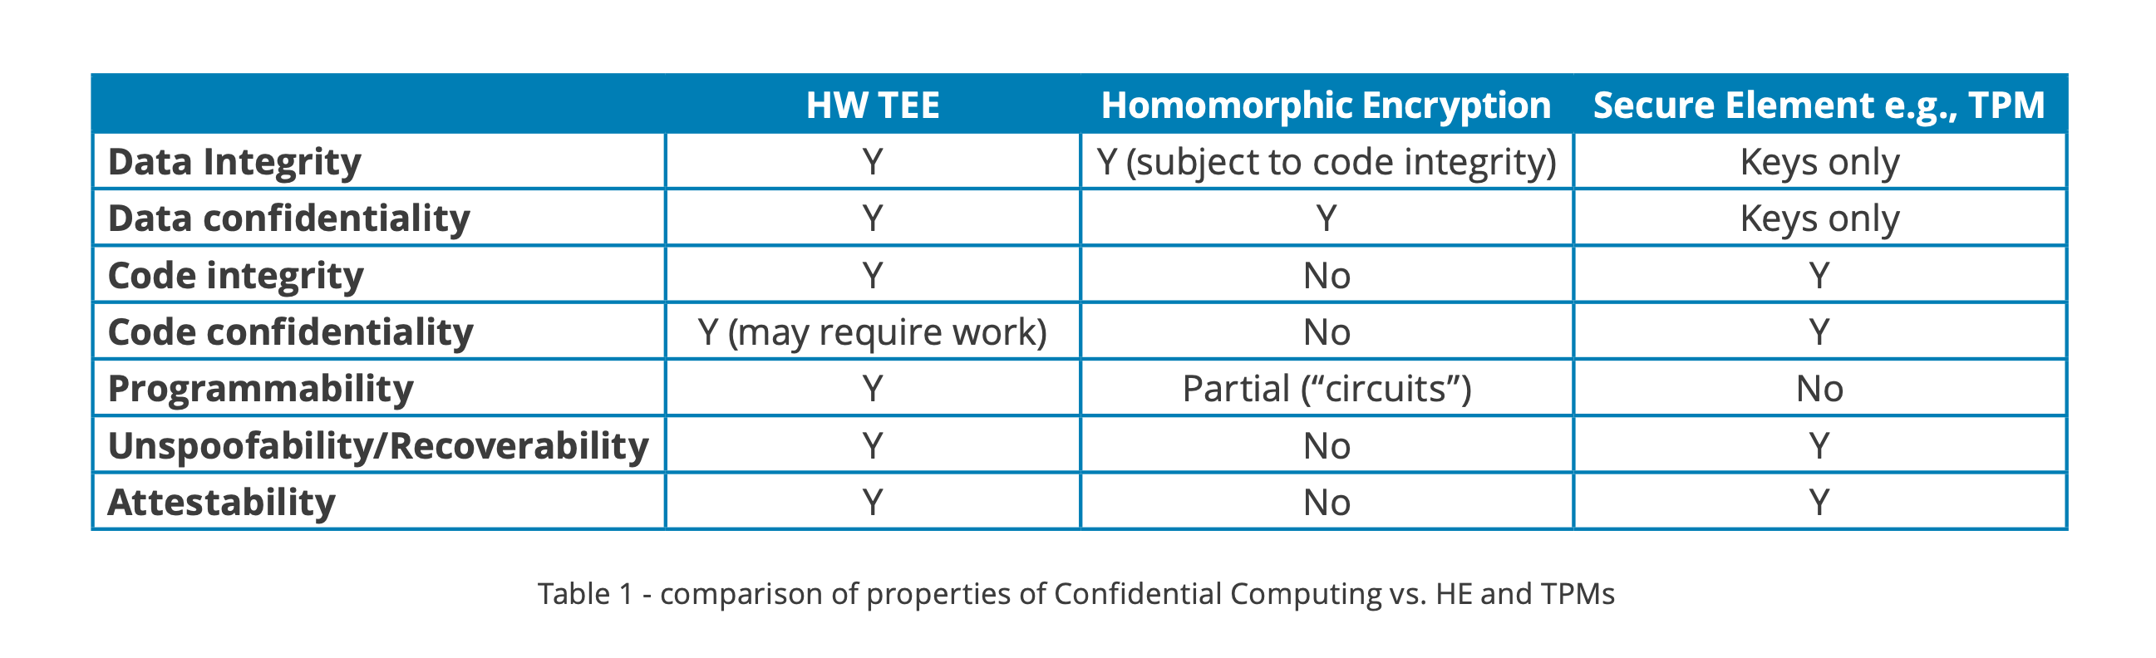
Confidential computing vs homomorphic encryption

Slide 47
Oppsummering
Kompletterer «klassisk» kryptering og beskytter data i hele livssyklus
Basert på hardware teknologier i TEE, og reduserer antallet elementer «man må stole på»
Skyleverandøren har ikke tilgang til dataene
Etablert teknologi, men nå skalert opp til å kunne kjøre på servernivå i skyinfrastruktur
Et regulatorisk krav i EU-GDPR, men like viktig internasjonalt
Gir public cloud et ytterligere sikkerhetsforsprang
I praksis vanskelig å se for seg auto-ML/AI-prosjekter som ikke benytter public cloud og confidential computing

